Slide 1
Identifying Trends and Insights
Overview
This lesson is designed to help students identify trends and insights in data. The focus is on using both traditional statistical methods and AI tools to draw meaningful conclusions from data sets.
Learning Objectives
Identify the different types of trends and insights that can be intuited by ADA.
Apply AI techniques to identify trends and insights in data at scale.
Use insights from ADA to make more informed decisions.

Slide 2
Suggested Agenda (30 min)
0:00-0:02 Review Learning Objectives
0:02-0:18 Identifying Trends and Insights
0:18-0:28 Practice: Asking Good Data Questions
0:28-0:30 Reflection
*these are estimates - timings will vary!

Slide 3
Teaching Guide:
Use the following quick tips for instructional guidance.
Title | What to Do
Learning Objective Slides | Pause to unpack the learning objectives and prime students for the lesson. This is a crucial step in the learning process and gives participants time to build context and activate any prior knowledge.
Solo Activities | For solo activities, you can choose to put people in group breakout rooms (to create the “table” group that they would be in in a physical setting) or allow students to work independently in the main session.
Group and Partner Discussions and Exercises (Remote) | Creating Breakout Rooms — Group and Partner Exercises Set up breakout rooms for pairs/groups. Broadcast directions and discussion questions to all breakout rooms. At the 60-seconds-left mark, broadcast a message to all rooms: “Start to wrap up your discussions. Rooms will close in one minute!” Move around from breakout room to breakout room to “walk around the classroom.”
Group and Partner Discussions and Exercises (In Person) | Facilitating Group and Partner Discussions and Exercises — Live Classroom Arrange the room prior to the session to create a conducive environment for group work. Provide clear, concise instructions verbally and on a handout or slide for the exercise, ensuring that all participants are aware of the goals and the time allocated. Circulate around the room to engage with groups Display a timer or announce when there is 1 min remaining Facilitate the sharing of group conclusions or discussion points with the whole class, ensuring that each group has a voice.

Slide 4
Identifying Trends and Insights

Slide 5
Identify the different types of trends and insights that can be intuited by ChatGPT.
Identify trends and insights in data by asking good data questions
Use insights from ChatGPT to make more informed decisions.

Slide 6
Identify Trends & Insights

Slide 7
The most serious mistakes are not being made as a result of wrong answers. The true dangerous thing is asking the wrong question.
Peter Drucker

Slide 8

Think About It: What makes a good data question? 🤔
Whether you’re briefing a Data Scientist or Business Analyst, what makes a question good or bad?
Type your response in the chat.
Notes:
Good questions are specific, clear, and focused on drawing insights from data, while bad questions are often vague, biased, or misunderstand the role of data professionals. Formulating effective questions involves understanding what data can reveal, the capabilities of data professionals, and how their insights can drive decision-making and strategy.

Slide 9

Formulating a Good Data Question
Narrow the Scope
Define the Objective
Formulate the Question
Identify Data/Constraints
Notes:
1. Define the Objective:
- Understand the Business or Research Goal:
Start by clearly understanding the business or research objective. What is the problem or decision you're facing? What kind of data-driven decision do you hope to make? This context is crucial for formulating a focused, relevant question.
- Consult with Stakeholders:
Engage with all relevant parties (like department heads, team members, or external clients) to gather diverse perspectives and understand the various needs. This collaboration can help ensure the question's relevance and applicability.

Slide 10
Formulating a Good Data Question
Narrow the Scope
Define the Objective
Formulate the Question
Identify Data/Constraints
Notes:
2. Narrow the Scope:
- Specify the Subject:
Clearly define what or who the subject of the question is (e.g., a particular customer segment, a product, a geographical area, etc.). This helps prevent the question from being too broad and unmanageable.
- Set Time Boundaries:
Decide on a specific time frame for your question, if applicable (e.g., "How has customer behavior trended over the past two years?"). Time constraints provide a way to limit the data you're considering and can help in observing trends or changes over specific periods.

Slide 11
Formulating a Good Data Question
Narrow the Scope
Define the Objective
Formulate the Question
Identify Data/Constraints
Notes:
3. Identify Available Data and Constraints:
- Assess Data Availability:
Determine what data you have available or can reasonably obtain. Your question should be ambitious, but it's also important to ground it in reality. You need to ensure that there's data available to answer your question or at least to approach an answer.
- Recognize Limitations:
Acknowledge the constraints you're working under. These might include budget, time, privacy regulations (like GDPR), or data collection limitations. These factors can all affect what questions you're able to pursue.

Slide 12
Formulating a Good Data Question
Narrow the Scope
Define the Objective
Formulate the Question
Identify Data/Constraints
Notes:
4. Formulate the Question:
- Use Clear and Concise Language:
Once you've laid the groundwork, formulate your question in a way that's direct and unambiguous. The clearer your question, the less room there is for misinterpretation during analysis.
- Ensure the Question is Actionable and Measurable:
Good data questions often lead to action — they should inform a decision or prompt a deeper understanding of a topic. Ensure the question is structured in a way that the results are measurable and can be tied back to the objective identified in step one.
- Refine and Review:
After drafting your question, review it with the key stakeholders you engaged with initially. They can help refine the phrasing, focus, and scope. This review process helps ensure the question is aligned with business or research objectives and is understood the same way by everyone involved.

Slide 13

Is this a good or bad question?
For the next few slides, you will be given a question and must determine if it is a good or bad question.
I will read the questions aloud.
You will respond with a thumbs up or thumbs down on the quality of the question.
Good = thumbs up
Bad = thumbs down
We will review the answer together.
OR
Notes:
PURPOSE: Engage learners in evaluating the quality of questions to promote critical thinking.
TALKING POINTS:
Discuss the characteristics that make a question effective for learning.
Encourage participation by having learners use visual signals to express their opinion.
TEACHING TIPS:
Provide examples of both good and bad questions before the activity to set a baseline understanding.
Encourage learners to explain their thumbs up or down decision to foster discussion.

Slide 14
Is this a good or bad question?
"What trends can we identify in customer behavior from the sales data of Q1 and Q2 in 2023 compared to the same period in 2022?"
Specific and Clear
This question is time-bound, topic-specific, and directly asks for an analytical perspective, enabling the analyst to focus on providing precise insights.

Slide 15
Is this a good or bad question?
"Can you tell me something interesting about our customers?"
Vague and Unclear
This question is vague and open-ended, making it difficult for the analyst to determine what specific data to analyze or the type of analysis the questioner is interested in.

Slide 16
Is this a good or bad question?
"Can you confirm that our latest product is the sole reason for the increase in this quarter's revenue?"
Implies a Desired Outcome
This question implies an expected answer and might pressure an analyst to confirm a preconceived belief, potentially leading to biased analysis.

Slide 17
Is this a good or bad question?
"Based on historical data, what factors seem to influence customer retention the most, and can we forecast retention rates for the next year?"
Encourages Prediction
This question seeks a deeper understanding of influencing factors and asks for a predictive model, encouraging the use of more advanced analytical skills.

Slide 18
Is this a good or bad question?
"What will be our exact revenue in the next five years?"
Beyond the Scope
While data scientists can forecast based on trends, asking for precise predictions over a long period can be unrealistic due to the countless variables that can affect future outcomes.

Slide 19
Is this a good or bad question?
"Given the recent user engagement data, what changes could we consider to improve our product’s user experience?"
Seeks Suggested Action
This question connects data analysis to strategic decision-making and asks the professional to provide actionable insights.

Slide 20
Is this a good or bad question?
"We hypothesize that the recent marketing campaign has increased our website traffic, but not our conversion rate. Does the data support this?"
Hypothesis Driven
Asking to validate or refute a hypothesis with data helps guide the analysis and connects it with business understanding.

Slide 21
Asking Good Data Questions

Slide 22
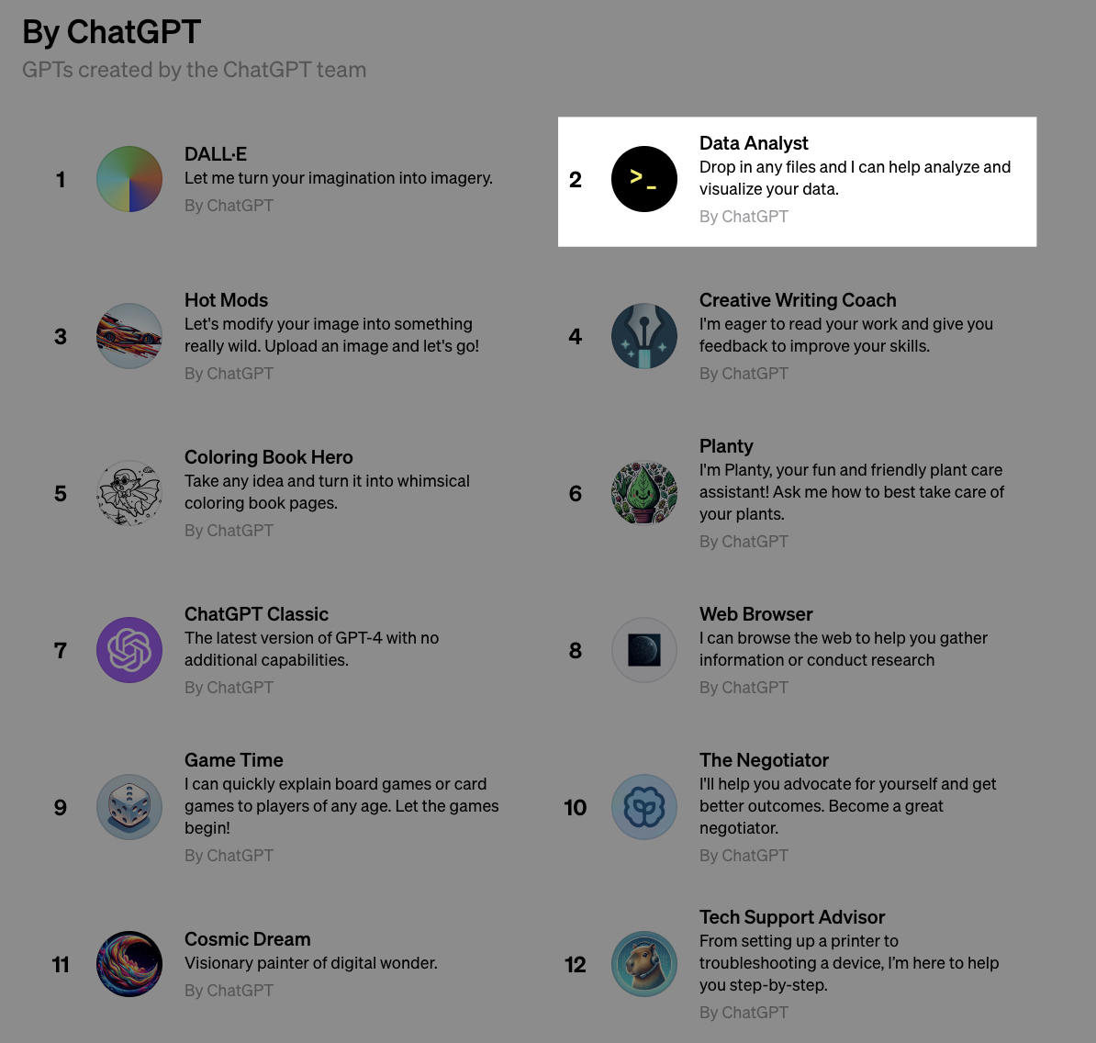
Asking Good Data Questions
First, visit chat.openai.com/gpts and choose Data Analyst

Slide 23
Asking Good Data Questions
Example Refinements:
10 Minutes
Upload ecommerce-data.csv.zip and provide both context and an objective for what you would like to achieve based on the analysis.
Instructions:
I believe .show() isn't available because your environment is sandboxed.
Work step-by-step, and pause to ask for feedback every so often.
If you need any further data, please ask for it.
We have a hypothesis that…
1
After some exploratory data analysis, narrow the scope of the analysis (product, geo, etc)
2
Get ChatGPT to outline constraints of the data, and ask if any more data or context is needed.
3
Formulate a good data question, and refine ChatGPT’s responses to find an answer.
Notes:
SOLO ACTIVITY
Go through the instructions - provide a quick demo if students are confused.
Students complete activity. Monitor their progress and answer questions throughout.
Debrief after the activity:
Reflect on the process of narrowing down your exploratory data analysis to a specific scope. How did this focus enhance the quality of your data question, and what insights did it reveal about the ecommerce data?
Considering the constraints and additional data requests you identified, how did these factors influence the formulation of your hypothesis and the subsequent data question you created?

Slide 24
Identify Trends & Insights

Slide 25
Reflection: Identify Trends & Insights
1
What errors or problems did you encounter with ADA? How did you overcome them?
2
What are some ways you might integrate ChatGPT when you need data analysis?
3
Given the importance of human involvement, what other skills would you need to develop?
Notes:
- Ask participants to reflect on their own, either in their own heads or by jotting down notes
- If they would like to share their reflections, let them know they can do so in the Zoom chat

